Slide 1

A Sustainable Urban Development
Solution
Waste Management

Slide 2

Harcourt Butler Technical University
B.Tech, Sophomore Year
Sundaram | Nikita | Saurabh

Slide 3
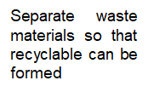
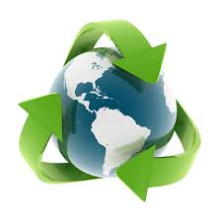
Use less, buy less, avoid waste, take shorter showers.
Use things more than once. Use cloth shopping bags, repair, re-gift, compost.

Slide 4
Problem Statement
Developing a technological solution to the waste problem of a city

Slide 5
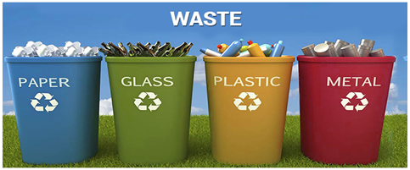
Plastic waste – This consists of bags, containers, jars, bottles and many other products that can be found in your household. Plastic is not biodegradable, but many types of plastic can be recycled. Plastic should not be mix in with your regular waste, it should be sorted and placed in your recycling bin.
Paper/card waste – This includes packaging materials, newspapers, cardboards and other products.
Tins and metals – This can be found in various forms throughout your home. Most metals can be recycled
Ceramics and glass – These items can easily be recycled. Look for special glass recycling bins and bottle banks to dispose them correctly.

Slide 6
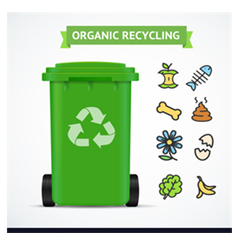
ORGANIC RECYCLING
Organics recycling is the recycling of organic material – anything that was once alive is turned into compost (a special soil amendment).
Composting happens naturally and requires very little energy input

Slide 7
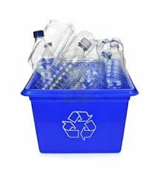
PLASTIC RECYCLING
Plastic recycling is the process of recovering different types of plastic material in order to reprocess them into varied other products, unlike their original form.
An item made out of plastic is recycled into a different product, which usually cannot be recycled again.

Slide 8
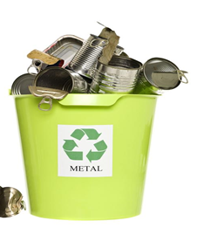
METAL RECYCLING
The good thing about metal recycling is that metal can be recycled over and over without altering its properties. The most common recyclable metals include aluminium and steel.
The other metals for example silver, copper, brass and gold are so valuable that they are rarely thrown away to be collected for recycling.

Slide 9
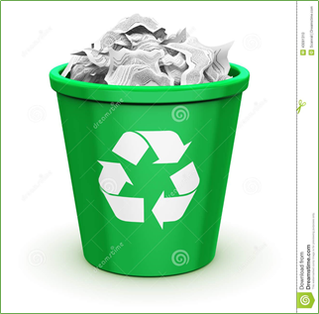
PAPER RECYCLING
The recycling of paper is the process by which waste paper is turned into new paper products.
It saves trees from being cut down.
It is less energy and water intensive than paper made from wood pulp.
It saves waste paper from occupying landfill and producing methane as it breaks down.

Slide 10

Recycling becomes more important on larger
scales. At this level, used consumer goods are
collected, converted back into raw materials and
remade into new consumer products. ... Recycled
paper, for example, contains ink residue and has
shorter fibers than virgin paper (paper made from
wood pulp).
Composting is the biological decomposition of
organic waste such as food or plant material by
bacteria, fungi, worms and other organisms under
controlled aerobic (occurring in the presence of
oxygen) conditions. The end result of composting is
an accumulation of partially decayed organic
matter called humus.
A landfill site (also known as a tip, dump, rubbish
dump, garbage dump or dumping ground and
historically as a midden) is a site for the disposal of
waste materials by burial. It is the oldest form of
waste treatment (although the burial part is
modern; historically, refuse was just left in piles or
thrown into pits).
The burning of garden waste produces smoke,
especially if the waste is green or damp. This
contains harmful pollutants including dioxins and
particulates. Burning of plastic, rubber or painted
materials creates noxious fumes.

Slide 11
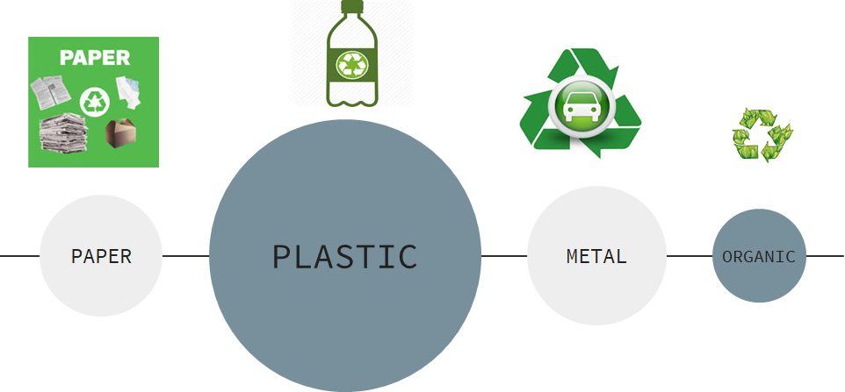

Slide 12
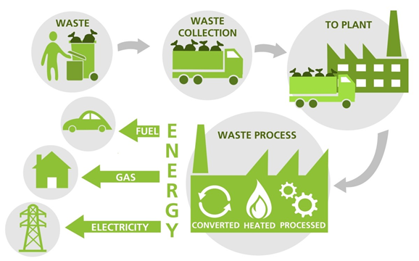
WASTE MANAGEMENT PROCESS

Slide 13
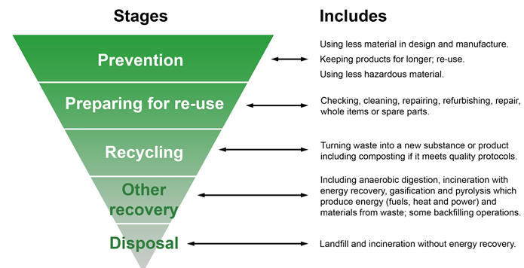
WASTE HIERARCHY

Slide 14
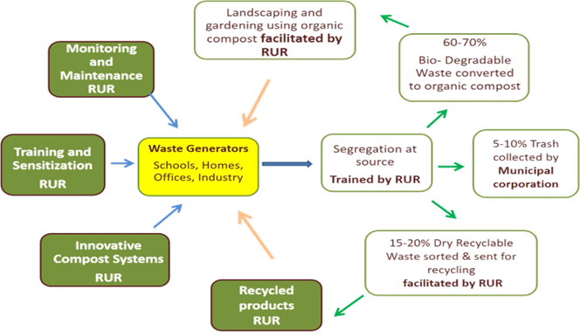
WASTE MANAGEMENT SOLUTION

Slide 15
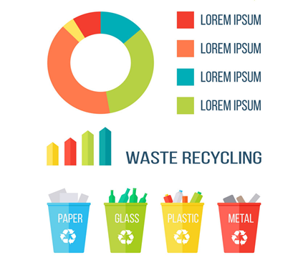
WASTE MANAGEMENT INFOGRAPHICS

Slide 16
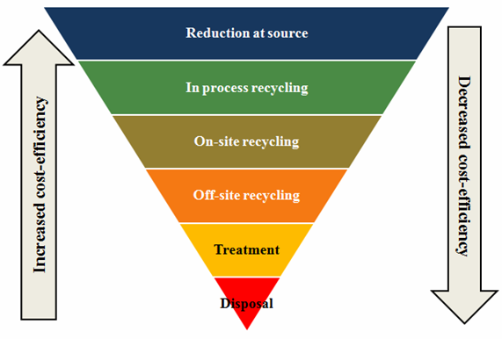
POLLUTION CONTROL PREVENTION

Slide 17
Our Approach
To solve this problem of waste management, we have created an application. With the help of this application we can register our complaint if there is any problem regarding waste management in our nearby.
Our approach is to target the lower level authorities to place the complaint so that it can be processed easily because we know that the higher the authority lower will be chance of getting our voice heard.

Slide 18
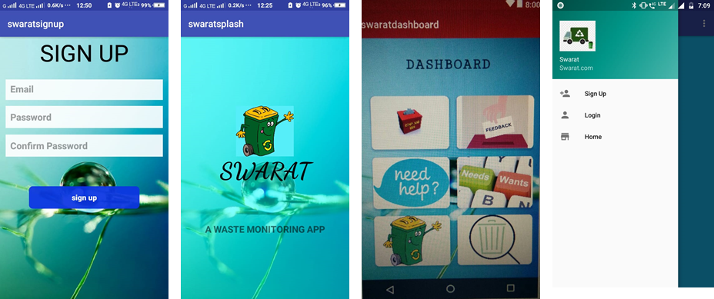
SCREEN-SHOTS

Slide 19
Thank You!
Sundaram | Nikita | | Saurabh

